Slide 1


Mitchell Kelly
08/16/23

Slide 2

Table of Contents
Executive Summary
Introduction
Methodology
Results
Conclusion
Appendix

Slide 3
Executive Summary
Space X Falcon 9 launches save millions of dollars reusing their first rocket stage instead of it going to waste by destruction. With historical Falcon 9 flight data it is possible to determine through the data alone whether the first stage will land successfully or not.
The flight data was collected entirely through a SpaceX API and web scrapping flight history data from Wikipedia. Once the required information was pulled from these sources, the data was processed by standardizing a binary class system which was either successful or unsuccessful for landing outcome. Several placeholder variables were used to allow for a more streamline statistical and machine learning model analysis after exploring the data for hidden insights.
It was determined through SQL querying, graphing in Python, and Dashboarding that Payload Mass and Flight number were the most significant indicators of landing outcome. It was not possible to observe a favorable outcome trend with data visualization alone, so several machine learning models were trained with optimal hyperparameters. KNN was observed to be the best model in terms of training time and accuracy score (0.77). A more expansive database of flight history is needed to improve the accuracy of the model.

Slide 4
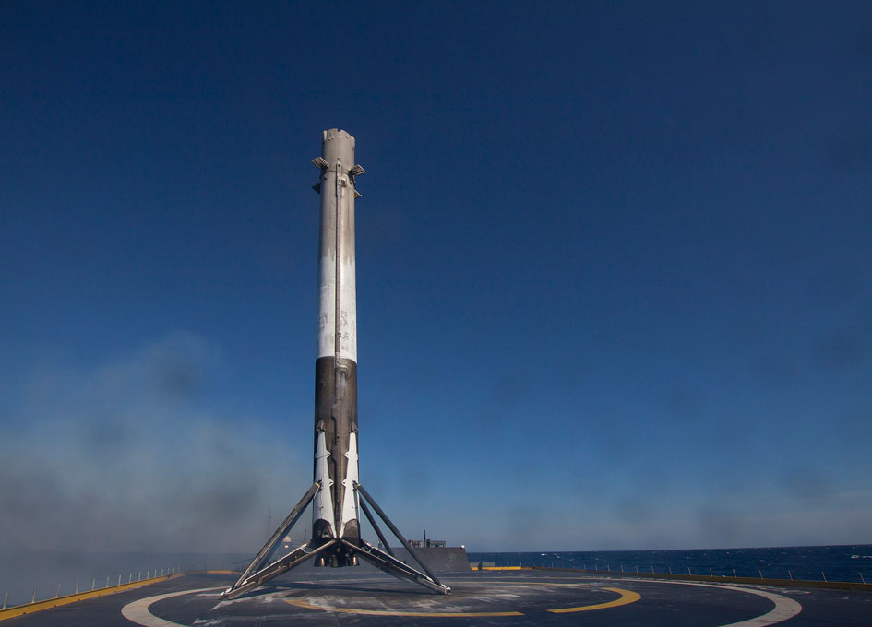
Introduction
SpaceX Falcon 9 launches cost 62 million dollars compared to 165 million of its competitors
Reusing the first stage of the rocket launch accounts for most of the price savings
Can we determine if the first stage will land using data driven insights and machine learning?
Is it possible to find a sufficiently accurate model that can determine if the first stage will land based upon historical flight data?

Slide 5

Section 1

Slide 6
Methodology
Executive Summary
Data collection methodology:
Describe how data was collected
Perform data wrangling
Describe how data was processed
Perform exploratory data analysis (EDA) using visualization and SQL
Perform interactive visual analytics using Folium and Plotly Dash
Perform predictive analysis using classification models
How to build, tune, evaluate classification models

Slide 7
Data Collection
Notebook
API
Database
Historical flight data was acquired using:
SpaceX API: https://docs.spacexdata.com/
Get requests with python functions to extract pertinent data
2) Wikipedia Web scrapping: https://en.wikipedia.org/wiki/List_of_Falcon_9_and_Falcon_Heavy_launches
BeautifulSoup library data extraction techniques

Slide 8
Data Collection – SpaceX API
Requesting and Parsing through SpaceX launch data with GET request
Filtering Pandas Dataframe (DF) for only Falcon 9 launces
https://github.com/mkelly44/Applied-Data-Science-Capstone/blob/main/jupyter-labs-spacex-data-collection-api.ipynb
https://github.com/mkelly44/Applied-Data-Science-Capstone/blob/main/dataset_part_1.csv
GET
JSON Response
API
Fetching Data
DF
Unrefined Pandas DF

Slide 9
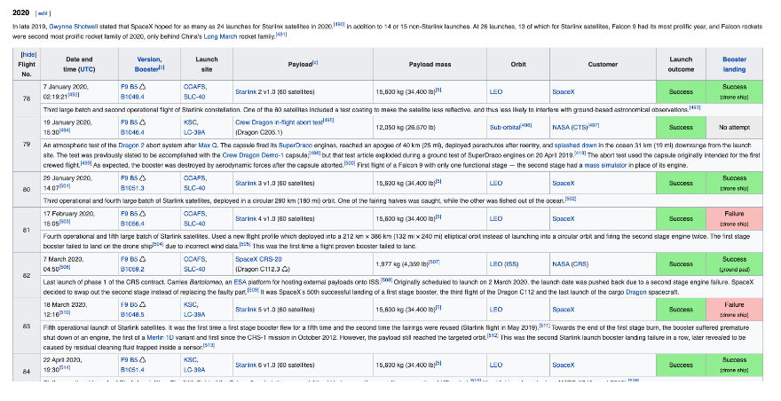
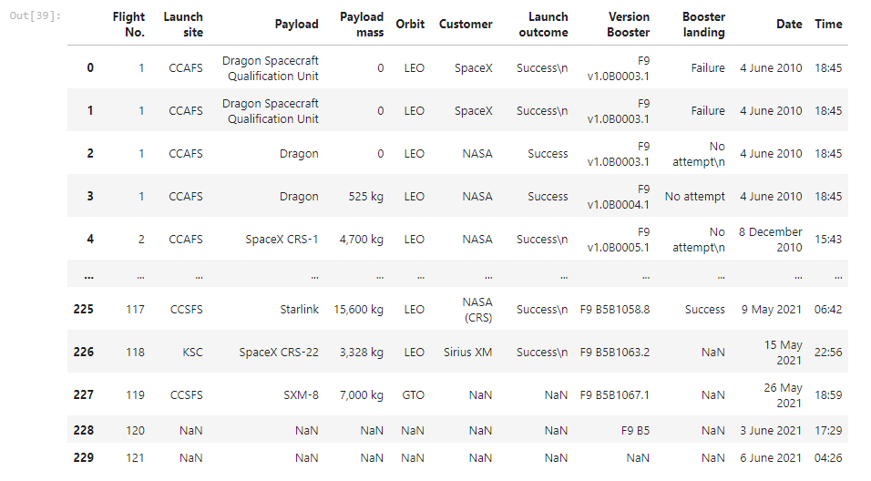
Data Collection - Scraping
Request call from the Falcon 9 Launch Wiki Page
Extracting all column names from HTML table header
Creating a new DF by iterating through launch HTML tables
https://github.com/mkelly44/Applied-Data-Science-Capstone/blob/main/jupyter-labs-webscraping.ipynb
https://github.com/mkelly44/Applied-Data-Science-Capstone/blob/main/spacex_web_scraped.csv

Slide 10
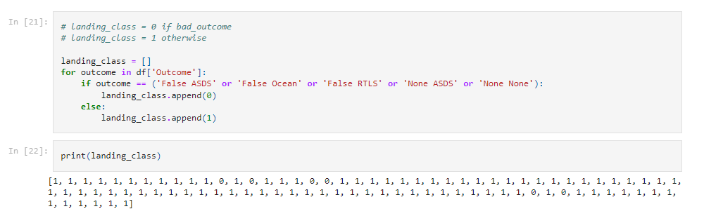
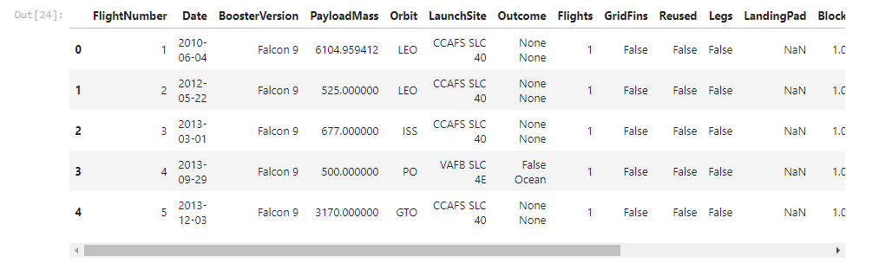
Data Wrangling
Dealing with Missing Values
Calculating the number of launches on each site
Determining the frequency of each specific orbit track
LEO, VLEO, GTO, SSO, ES-L1, HEO, ISS, MEO, HEO, GEO, and PO
Calculating the occurrence and amount of mission outcomes for each orbit
Creating a labeled outcome list based upon mission outcomes
Features Engineering with placeholder variables
https://github.com/mkelly44/Applied-Data-Science-Capstone/blob/main/IBM-DS0321EN-SkillsNetwork_labs_module_1_L3_labs-jupyter-spacex-data_wrangling_jupyterlite.jupyterlite.ipynb

Slide 11
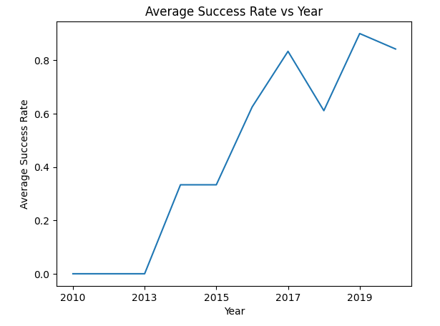
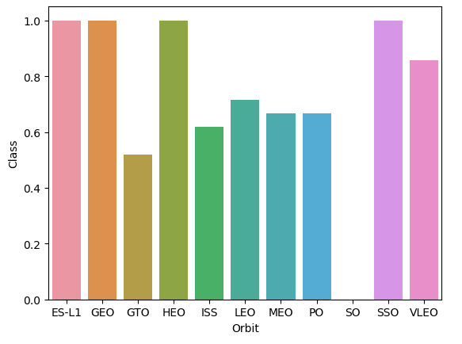
EDA with Data Visualization
Each Chart plots two features against each other to determine their correlation and if a specific trend can be observed
An additional element of Successful Mission (1) or Unsuccessful Mission (0) is present so the correlations can be related to outcomes
Categorical Plot of Flight Number and Payload Mass
Categorical Plot of Flight Number and Launch Site
Scatter Plot of Payload Mass and Launch Site
Bar Plot of Orbit Type and Mean Success Rate
Scatter Plot of Flight Number and Orbit Type
Scatter Plot of Payload Mass and Orbit Type
Line Plot of Average Success Rate over Years
https://github.com/mkelly44/Applied-Data-Science-Capstone/blob/main/IBM-DS0321EN-SkillsNetwork_labs_module_2_jupyter-labs-eda-dataviz.ipynb.jupyterlite.ipynb

Slide 12
EDA with SQL
SQL Queries seek to display pertinent exploratory data analysis findings in an easily digestible manner
Displaying Names of Unique Launch Sites
Selecting 5 Launch Sites Beginning with CCA
Displaying Total Payload Mass from Rockets Launched by NASA
Displaying Average Payload Mass from booster version F9 v1.1
Listing Date of First Successful Ground Pad Landing
Finding Booster Names with Payload Mass greater than 4000, but less than 6000
Calculating Total Successful and Failure Mission Outcomes
Finding Booster Names with Maximum Payload Mass
Displaying Failure Landing Outcomes in 2015
Calculating Frequency of Landing Outcome Type
https://github.com/mkelly44/Applied-Data-Science-Capstone/blob/main/jupyter-labs-eda-sql-coursera_sqllite.ipynb

Slide 13
Build a Dashboard with Plotly Dash
Created Pie Chart Showing Successful Launches for All or Specific Launch Sites
Can effectively see what launch site has the most successful landing outcomes
Showcased the Correlation Between Payload Mass and Outcome for All or Specific Booster Versions with a Category Plot
Can see what booster type correlates the most with successful landing outcomes, and a payload mass slider was added to refine results further
https://github.com/mkelly44/Applied-Data-Science-Capstone/blob/main/spacex_dash_app%20(1).py

Slide 14
Predictive Analysis (Classification)
Segmented columns of Dataframe into target variable Y and normalized features set X
Split X and Y into train and test data portions
Used GridSearchCV from sklearn with several parameters to optimize results for each method employed: Logistic Regression, SVC, Decision Tree, and KNN
Each machine learning method was fit with best hyperparameters to maximize the accuracy of prediction
SVM was chosen as the best performing model based upon accuracy score and minimal training time
https://github.com/mkelly44/Applied-Data-Science-Capstone/blob/main/IBM-DS0321EN-SkillsNetwork_labs_module_4_SpaceX_Machine_Learning_Prediction_Part_5.jupyterlite.ipynb
Processing
Training
Evaluation

Slide 15
Results
Exploratory Data Analysis Results:
ES-L1, GEO, HEO, and SSO orbits have had successful first stage landing for every mission
CCAFS LC-40 has a 60% success rate while both KSC LC-39A and VAFB SLC 4E have a success rate of 77%
LEO orbit had 100% success rate after less than 10 flights up to 40+
From 2013 to 2019 average success rate has increased roughly 10% each year
Predictive Analysis Results:
KNN and SVM had an accuracy score of 0.77 each
Logistic Regression and Decision Tree has an accuracy score of 0.72 each

Slide 16

Section 2

Slide 17
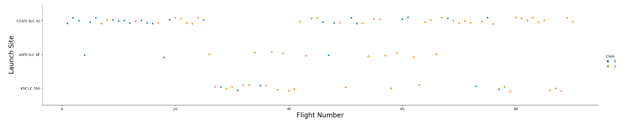
Flight Number vs. Launch Site
After Flight Number 80, every launch site takeoff has a successful landing outcome.
CCAFS SLC-40’s unsuccessful launches are heavily distributed towards lower flight number

Slide 18
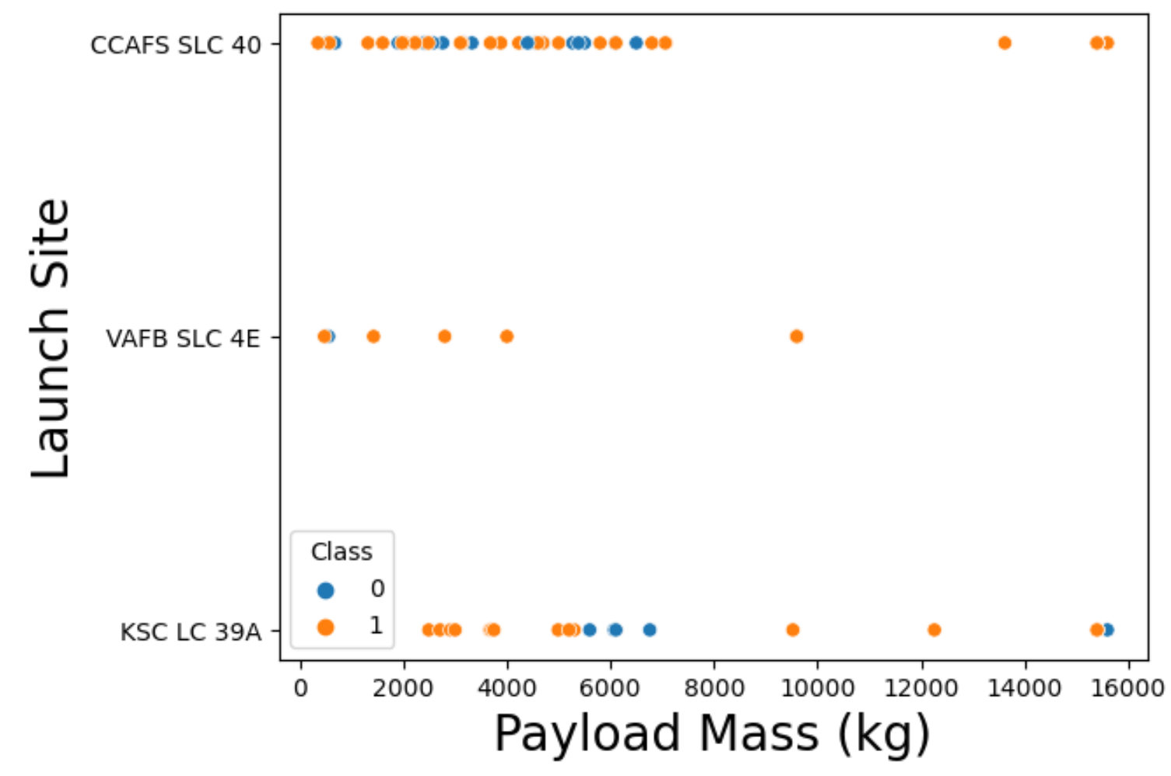
Payload vs. Launch Site
For VAFB SLC 4E there are no payload sizes greater than 10,000 kg.
Large payload size (12,000+ kg) for CCAFS SLC-40 has 100% success rate, yet most of its launches occurred in the less than 8,000 kg range.

Slide 19
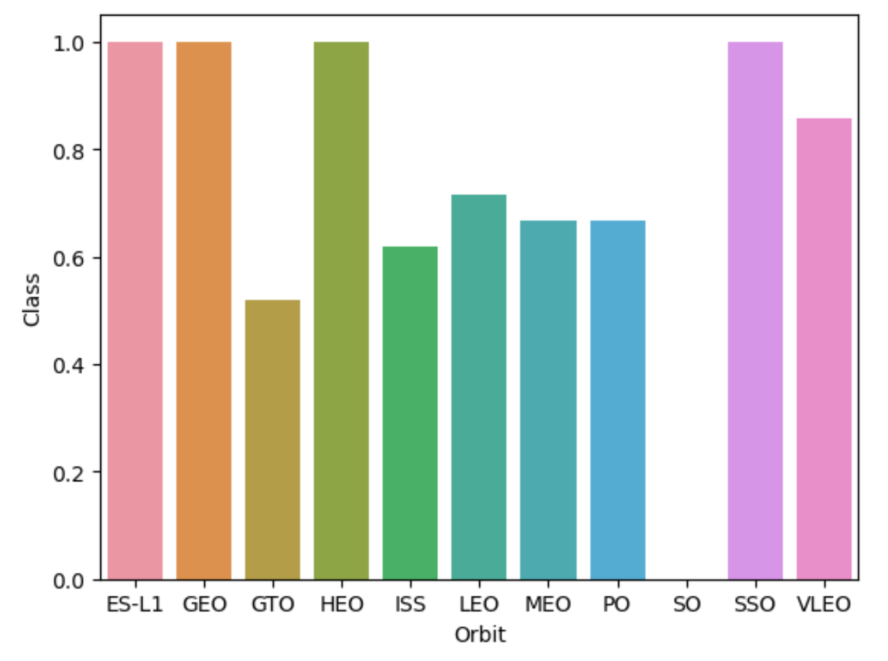
Success Rate vs. Orbit Type
GTO orbits have an average success rate of 0.5
ES-L1, GEO, HEO, and SSO orbits have a success rate of 1.0
SO orbit launches have never had a success.

Slide 20
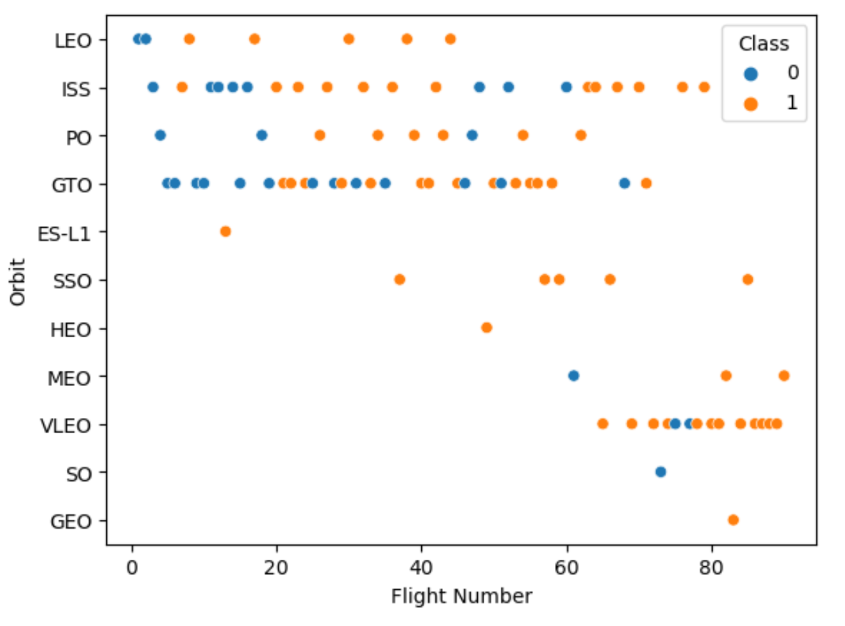
Flight Number vs. Orbit Type
LEO orbit success rate depends entirely on increasing Flight Number.
GTO orbits have the most flights, yet the relationship between success rate and flight number is inconclusive.

Slide 21
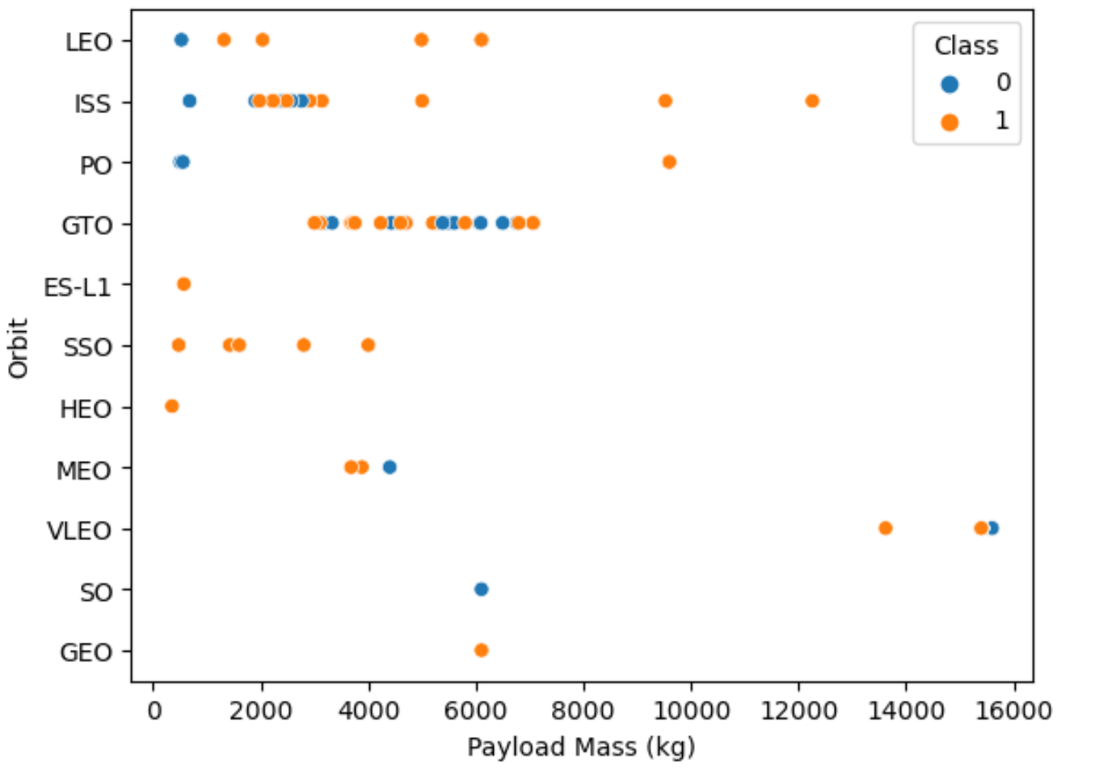
Payload vs. Orbit Type
For heavier payloads in PO, LEO, and ISS orbit, the success rate is higher.
GTO orbits have an inclusive relationship with payload mass.

Slide 22
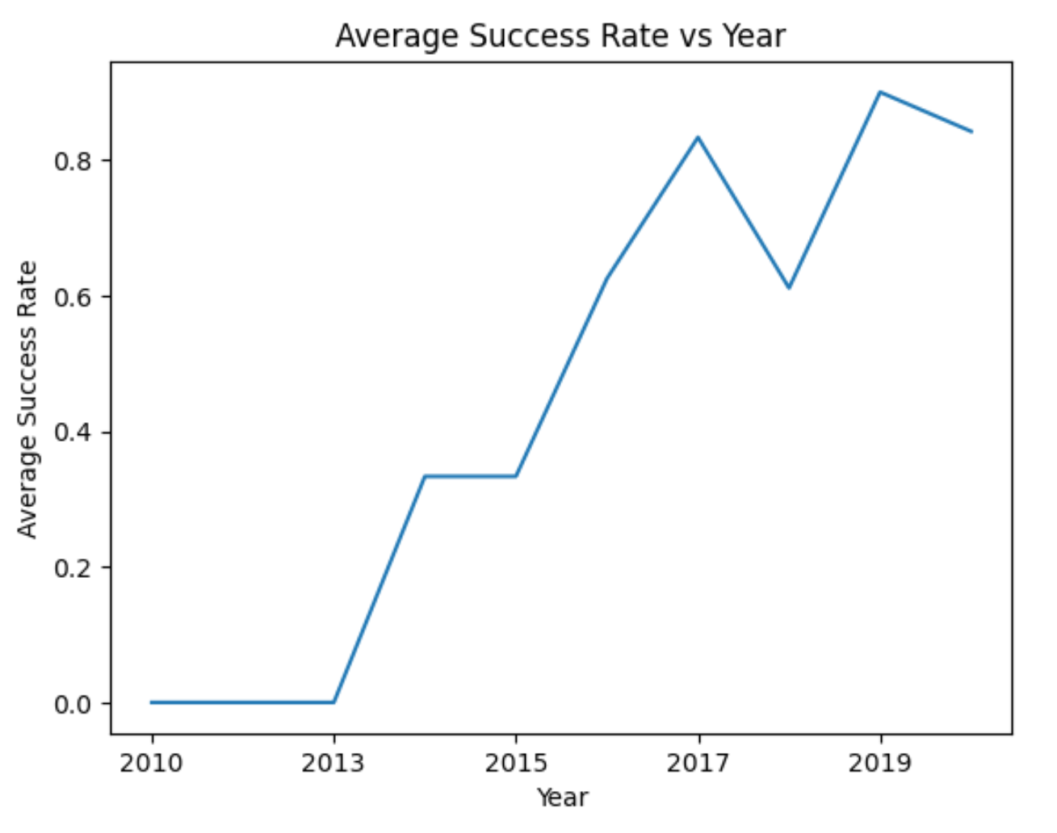
Launch Success Yearly Trend
From 2013 to 2020, the average success rate increases around 0.1 per year.
A dip in average success rate was exhibited in 2018, but it did not affect the long term outlook.

Slide 23
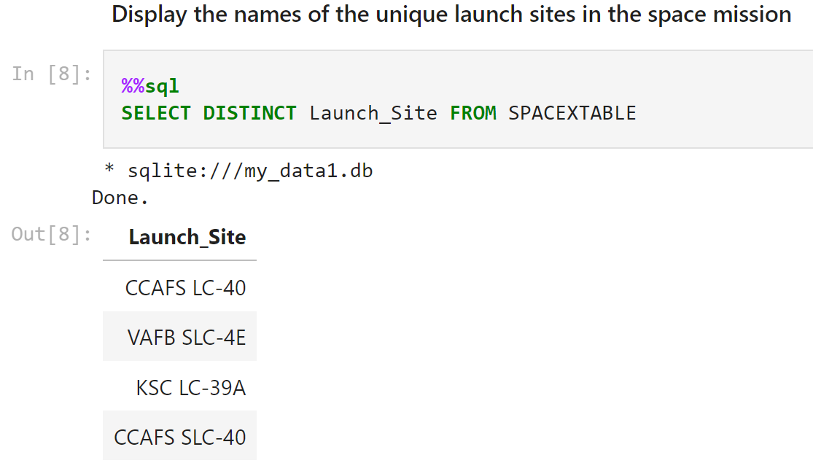
All Launch Site Names
All the unique launch site names were needed to conceptually simplify where rockets would launch from.

Slide 24
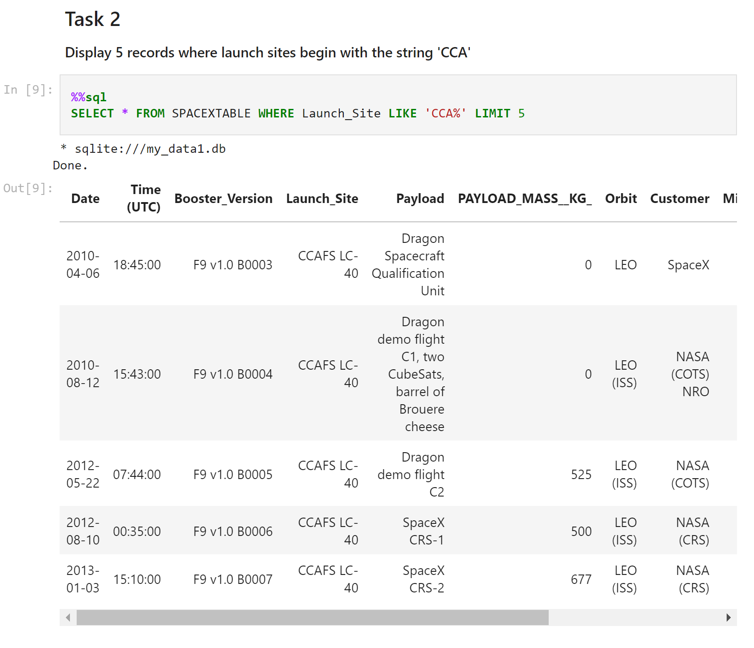
Launch Site Names Begin with 'CCA'
Query was completed to get a general picture of CCAFS LC-40 launch site data.

Slide 25
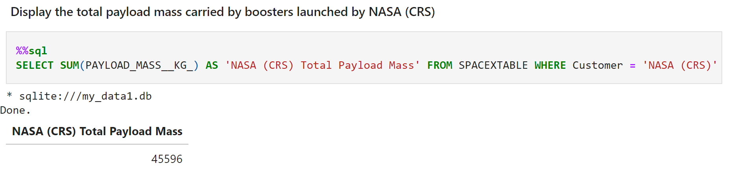
Total Payload Mass
Total NASA customer payload was queried to compare with other customers

Slide 26
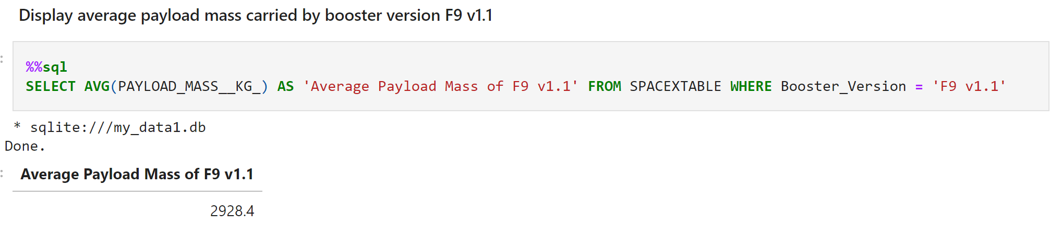
Average Payload Mass by F9 v1.1
Average payload mass from booster version F9 v1.1 rockets was queried for data analysis.

Slide 27
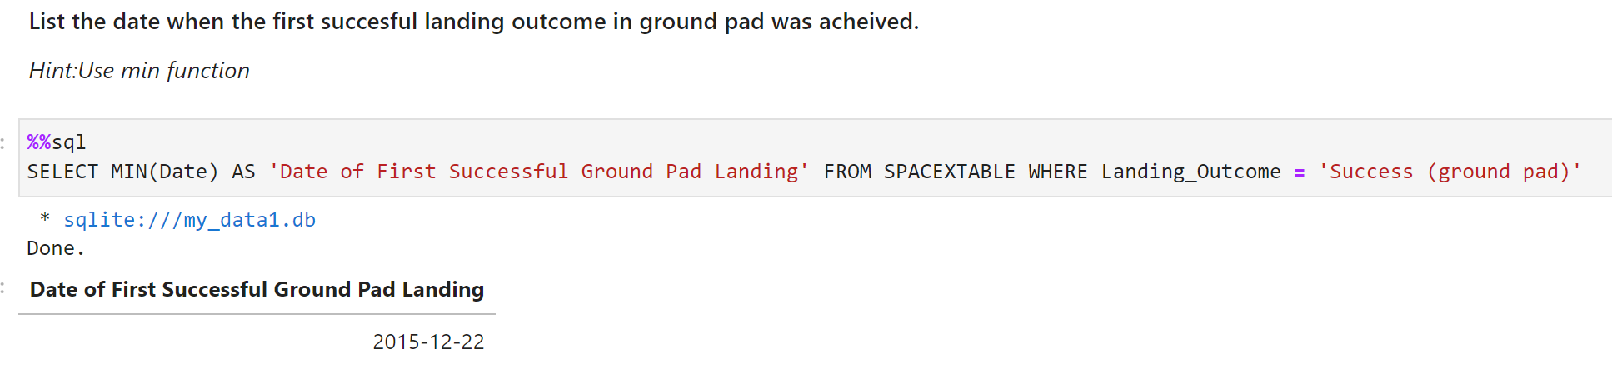
First Successful Ground Landing Date
The first successful ground landing date was queried to signifiy the start of when the first stage of Falcon9 rockets began to land.

Slide 28
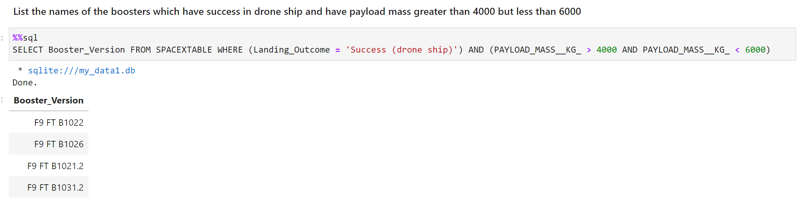
Successful Drone Ship Landing with Payload between 4000 and 6000
Query of successful drone ship landing with payload between 4000 and 6000 shows what are the popular booster versions for successful landing outcomes.

Slide 29
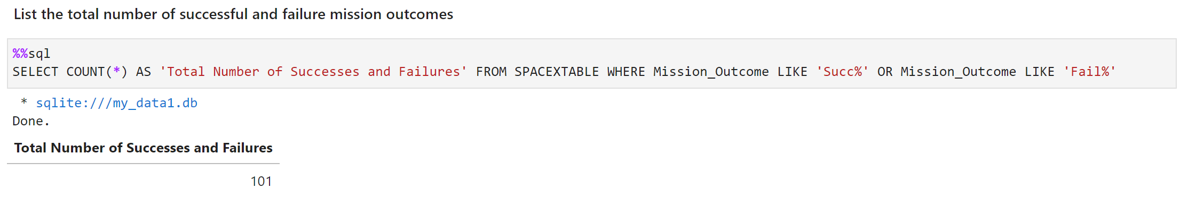
Total Number of Successful and Failure Mission Outcomes
The total number of successful and failed mission outcomes query was needed to see how many individual instances there were.

Slide 30
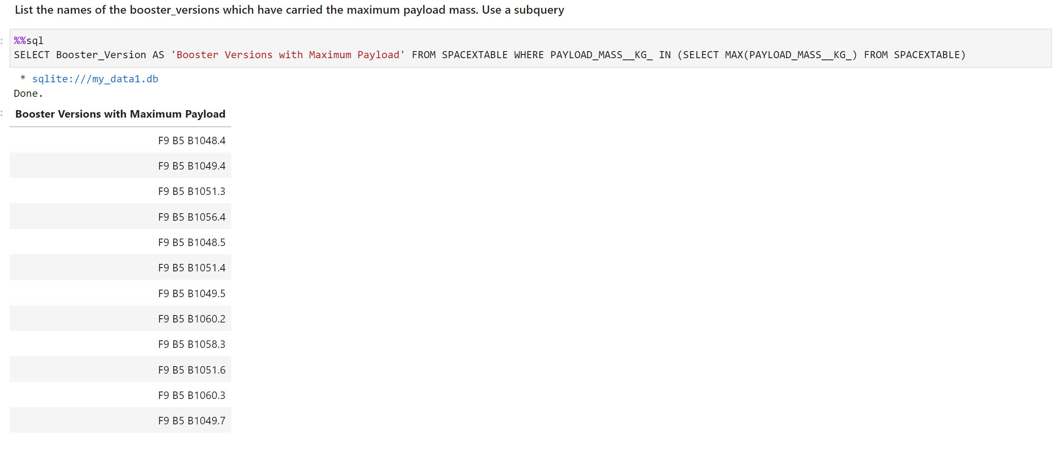
Boosters Carried Maximum Payload
A query containing the booster versions of a maximum payload launch helps differentiate between the individual launches better.

Slide 31
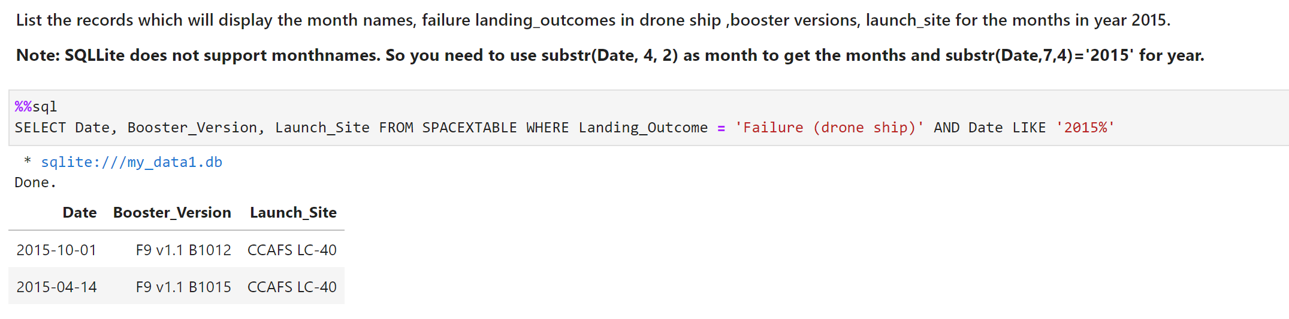
2015 Launch Records
Querying information about failure landing outcomes in 2015 indicates what booster and what launch site was responsible for the undesired outcome.

Slide 32
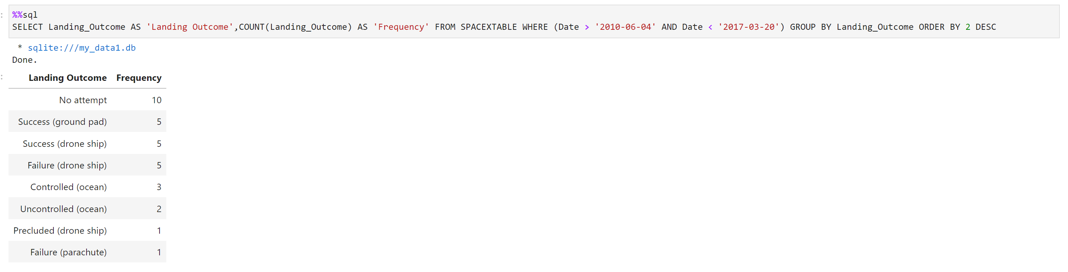
Rank Landing Outcomes Between 2010-06-04 and 2017-03-20
Querying a descending list of landing outcomes from 2010 to 2017 shows the complete picture of the data for that time period.

Slide 33

Section 3

Slide 34
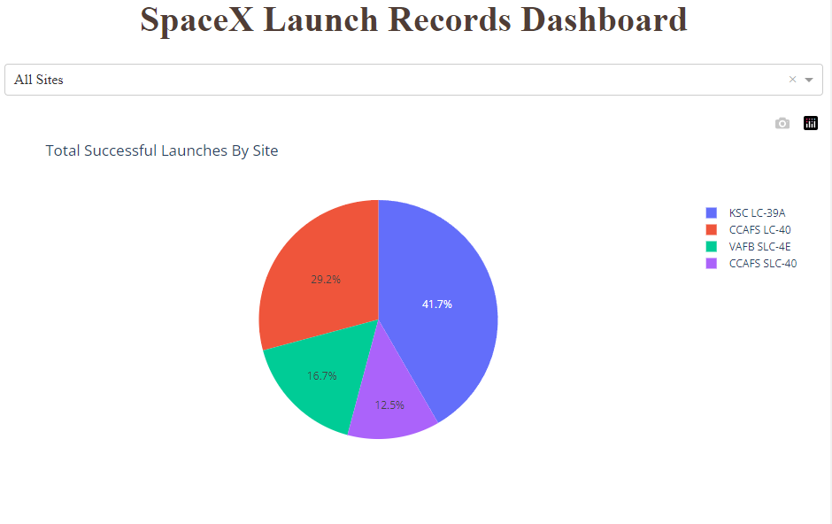
Total Successful Launches By Site Pie Chart
KSC LC-39A has the most amount of successful launches
CCAFS SLC-40 has the least amount of successful launches
https://github.com/mkelly44/Applied-Data-Science-Capstone/blob/main/spacex_dash_app%20(1).py

Slide 35
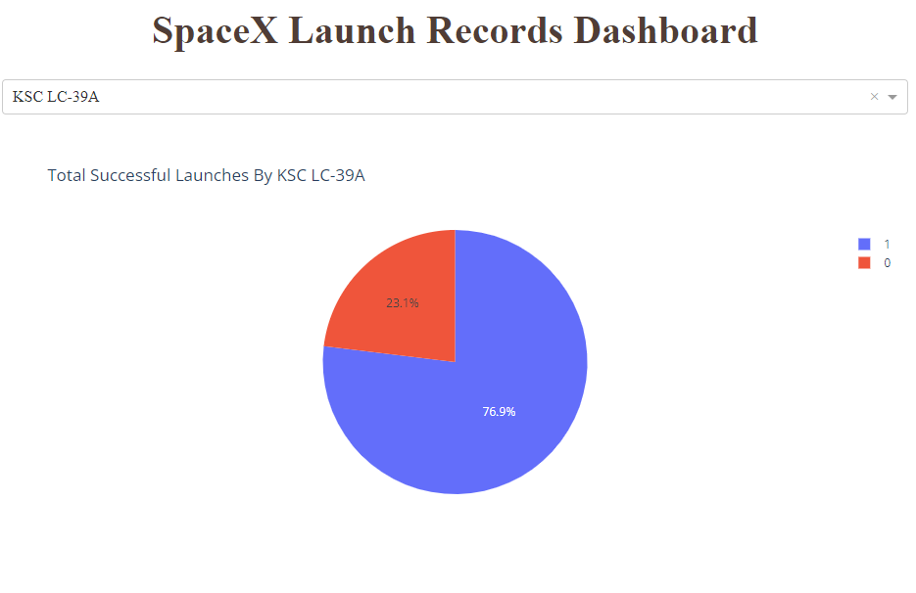
76.9% of all launches from KSC LC-39A launch site have the first stage land successfully.
Shows that 3 out of every 4 rockets will have a landing first stage if they took off from KSC LC-39A.
Total Successful Launches By KSC LC-39A

Slide 36
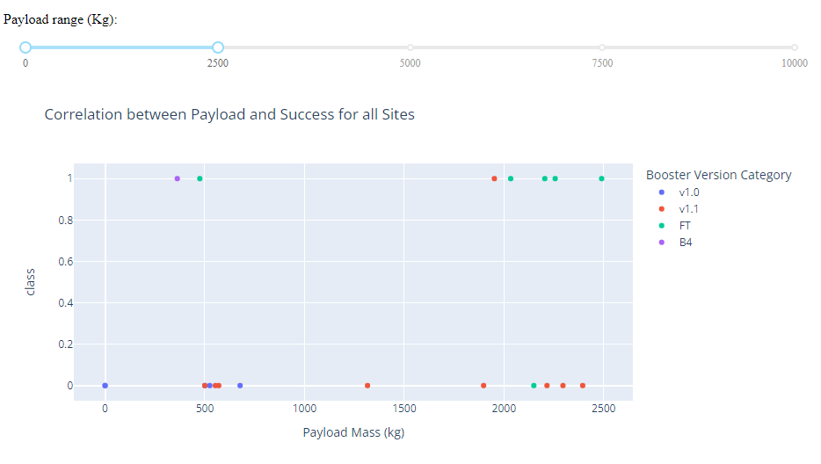
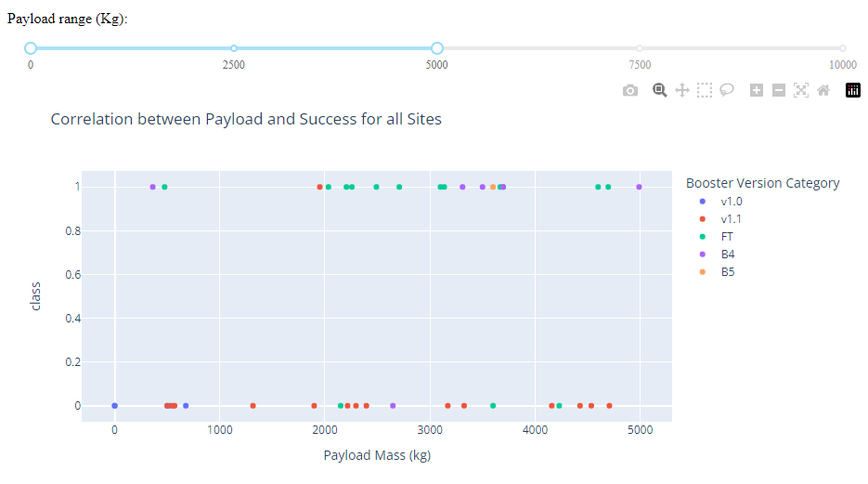
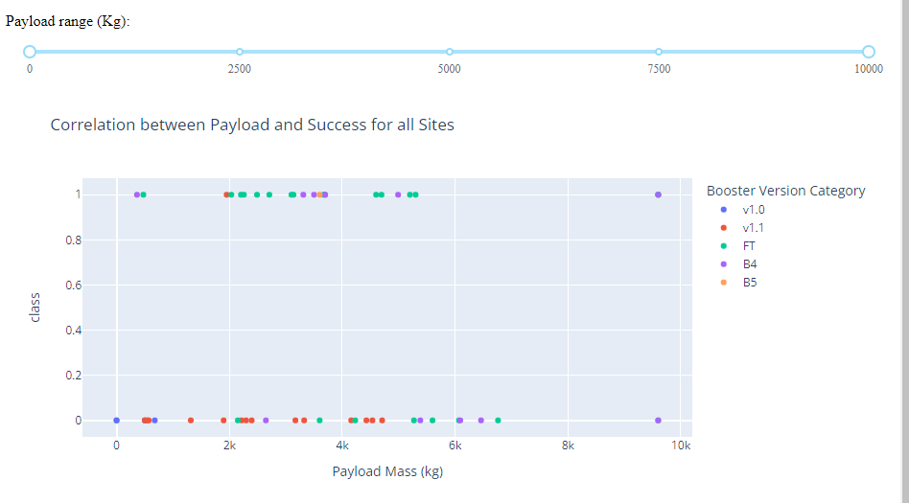
Correlation Between Payload and Success for all Sites
In the range of 0-2500 kg of payload mass, the FT booster has the most successful outcomes.
For both the 0-2500 kg and 0-5000 kg range of payload mass, booster version v1.1 has only a single successful landing.
Although FT and B4 consistently result in a successful outcome, their unsuccessful outcomes are equally as frequent.
The B5 booster has a 100% success rate, but only one launch was recorded.

Slide 37

Section 4

Slide 38
Classification Accuracy
KNN and SVM tied for highest accuracy model
KNN best model since hyperparameter based accuracy the highest, and training time is 2x faster than SVM

Slide 39
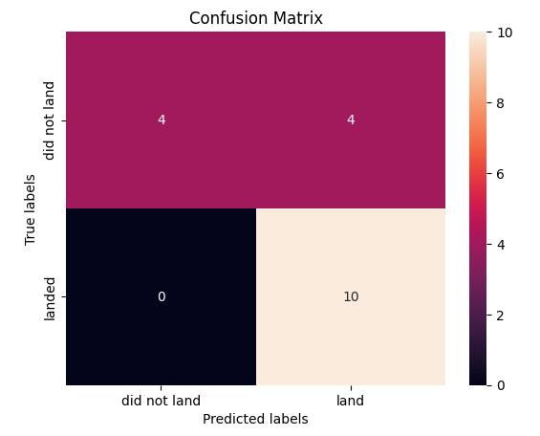
Confusion Matrix
KNN predicted all10 landing labels correctly and none incorrectly
KNN split the correct labeling for first stage not landing 4 to 4
KNN model is very good at predicting true “landed” labels but not true “did not land” labels.

Slide 40
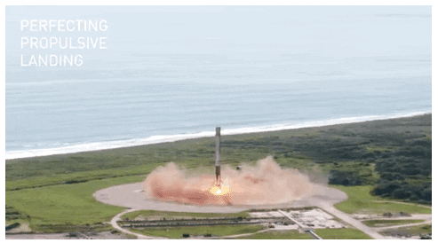
Conclusions
The KNN machine learning model for first stage rocket landing outcome was the most accurate with a score of 0.77
As more rockets launch from SpaceX, more data will be available to increase the accuracy of the model even further, for more accurate predictions
Flight Number and Payload Mass were the most impactful features because more flights and heavier payloads tended to have their first stage land successfully, more often

Slide 41
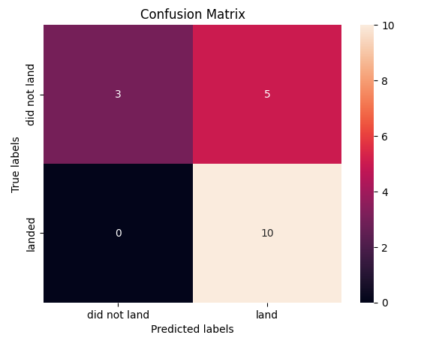
Appendix
Confusion Matrix for Logistic Regression and Decision Tree (both had exact same values)

Slide 42


